Slide 1


Building the HCP Journeys
IBD International
May 5th 2021

Slide 2
Introductions

Slide 3
HCP Journey Workshop Agenda - IBD
Attendees
International team: Patrick, Elisa, Deborah, Geert, Alessandra, Secil, Camille, Clare, Johan
Alexandre/Gareth/Alex (Veeva) Arsida/Anjela/Neil/Veronica (DDB) Alice (OpenHealth)
Time | Topic | Facilitator | Format
14:00-14:10 | Team introductions | Patrick / Veeva | Roundtable
14:10-14:20 | Project Overview | Patrick / Veeva | Presentation
14:20-14:35 | Working session: Journey Framework - Events & Key Moments | Eeva / Veeva | Interactive Session
14:35-14:50 | Progress Sharing & Tool Demo | Veeva | Presentation
14:50-15:15 | Working session Review and starting to iterate the international journeys | Gareth/Alex | Breakout Session Groups
15:15-15:25 | Debrief & group discussion | all | Presentations back to the group
15:25-15:30 | Next steps | Gareth/Alex

Slide 4


Workshop Roles
We are against the clock!
We only have a short amount of time together, lets be focused on having a super-efficient remote session.
Time-Keeper:
Let’s stay on-topic!
Everyone is very busy, and so keeping ‘on topic’ and always working towards the project outputs will be key.
‘Rabbit-Hole’ Monitor:

Slide 5



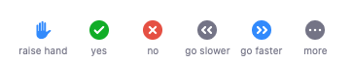
Mechanics of zoom
Virtual workshop
Non verbal cues
Break out rooms
Zoom works much like webex or Teams – optimally with video enabled.
If you have any problems, ask one of the Veeva team for help.
Use ’cues’ to signal how you feel – especially if you have a question or want us to repeat something.
For smaller group discussions, we use ‘breakout rooms’. You don’t need to do anything – this will happen automatically.
‘Cues’ are found at the bottom in the ‘Participants’ tab

Slide 6
Project Overview

Slide 7

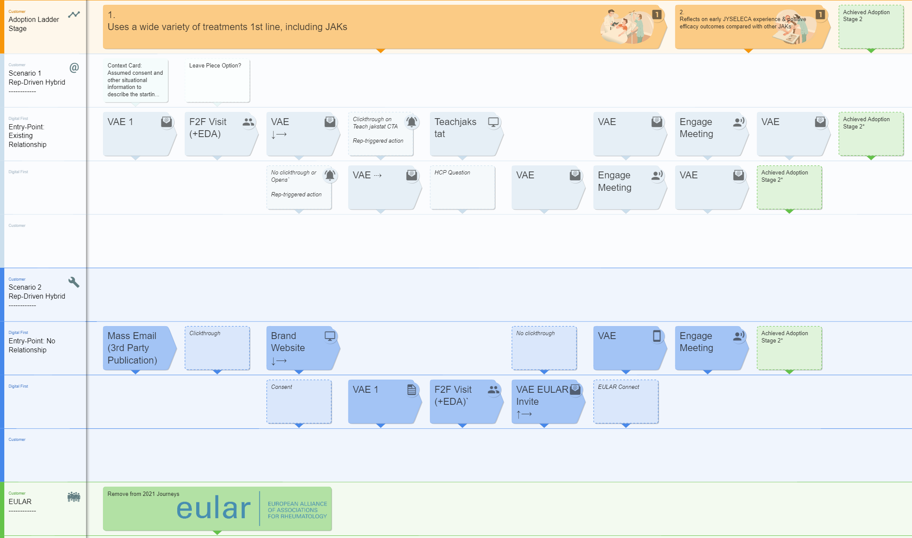
What is the HCP Journeys Project?
A cross functional team is now making strategy a reality, by creating HCP Journeys that bring together existing content, OC channels and research…
…into maps to guide the rapid movement of HCPs through stages in the adoption ladder.
Illustrative example

Slide 8

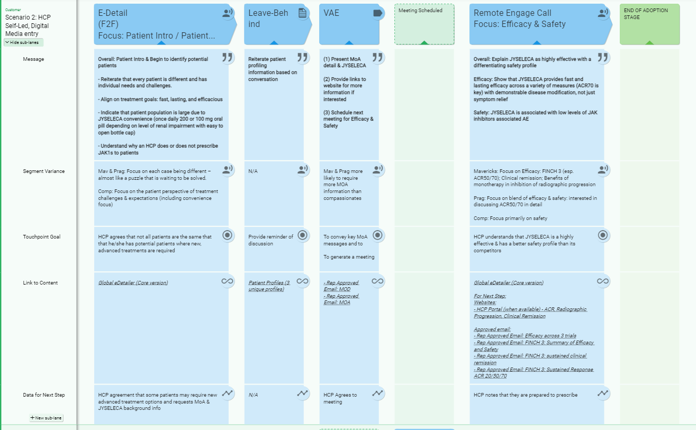
What will you get at the end?
A clear Customer Journey for your market, for the IBD indication, linked to driving HCPs up the initial stages in the adoption ladder
Journeys that are linked to content both existing and currently in production for launch, with easy access to the materials needed for execution (and view on planned content)
An easy-to-use Customer Journey format, to enable dynamic updates throughout the year

Slide 9
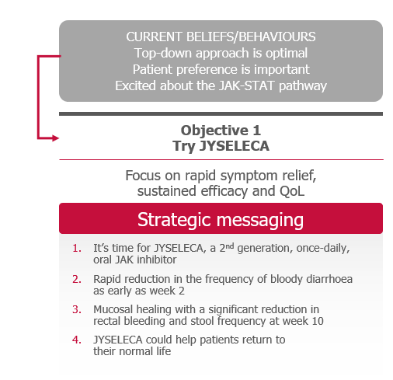
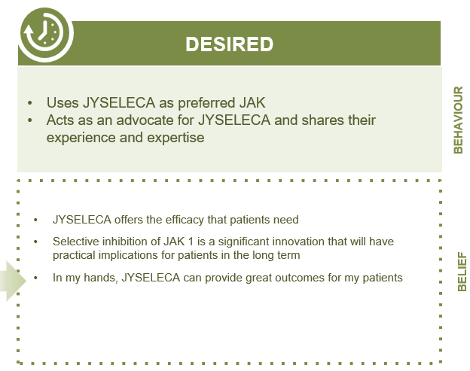
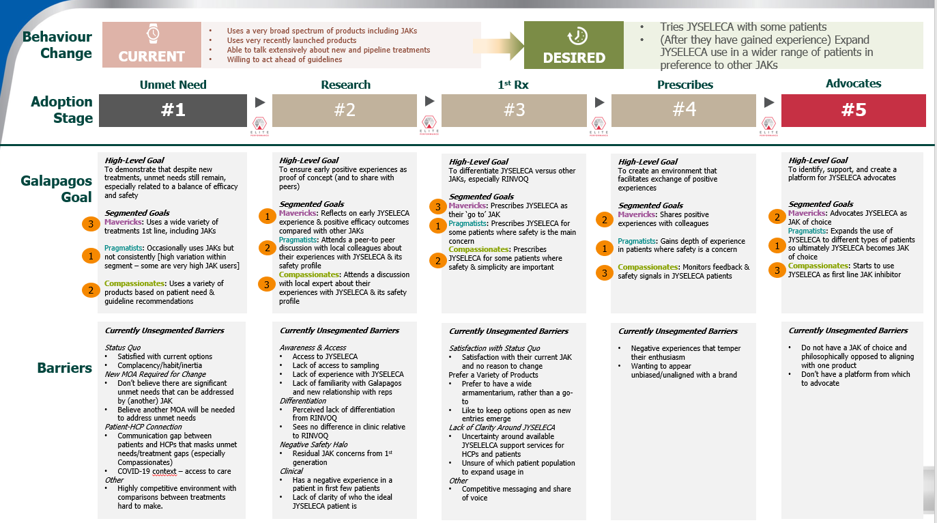
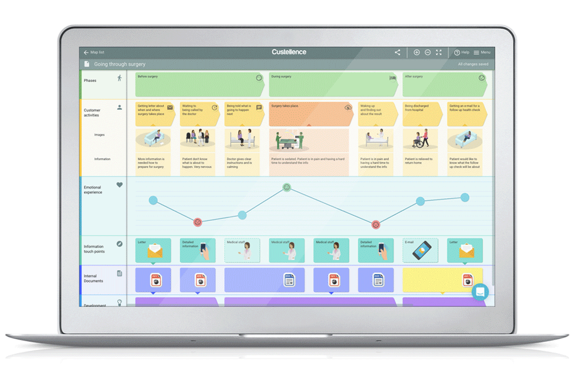



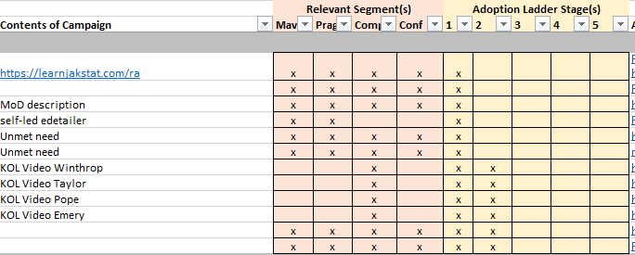

The Approach is Consistent & Cross-Functional
Brand / Strategy
Brand / Strategy
Marketing / Medical Maps
Leverage existing Strategy
Organise it for market clarity
Develop the Journeys
Research | Segmentation Channels | Content
The execution-focused mapping of the touchpoints with a HCP.
Adoption Ladder consolidation & consistent format
International illustrative Versions
IBD Segmentation
Content alignment to segmentation and adoption ladder stage
Localised executable Versions
Complete
In progress
In progress

Slide 10
How we are making this a reality
To reduce market workloads and to maximise outputs, we are working via a localisation model, with heavy support to markets between engagements.
March |  |  | April | April |  |  | May | May |  |  | June
15th | 22nd | 29th | 5th | 12th | 19th | 26th | 3rd | 10th | 17th | 24th | 31st | 7th | 14th | 21st
Leverage existing Strategy
Creation of consolidated, granular Adoption Ladder, to bring clarity to the brand strategy, research and segmentation
International Journey Creation
Creation of a set of scenario-driven customer journeys, to act as the template for localisation
Journey Localisation
Supported localisation of international Journeys
Brand - IBD
Germany (RA & IBD)
CI&E - OC
UK
workshops to occur- Sept’21
CI&E - SFE
IBD International Journeys currently in development
CRM & Technology
Smaller Markets
Shorter engagements with lighter localisation, leveraging both international and larger market Journeys. Workshop dates TBD
Market Research
Partner Agencies
3 x 2hr, cross functional market workshops.
With markets supported in the interim for the time-intensive activities
Today

Slide 11
Working Session - Framework

Slide 12

Customer Journey Framework
What are the framework elements that we should include in the journeys?

Slide 13





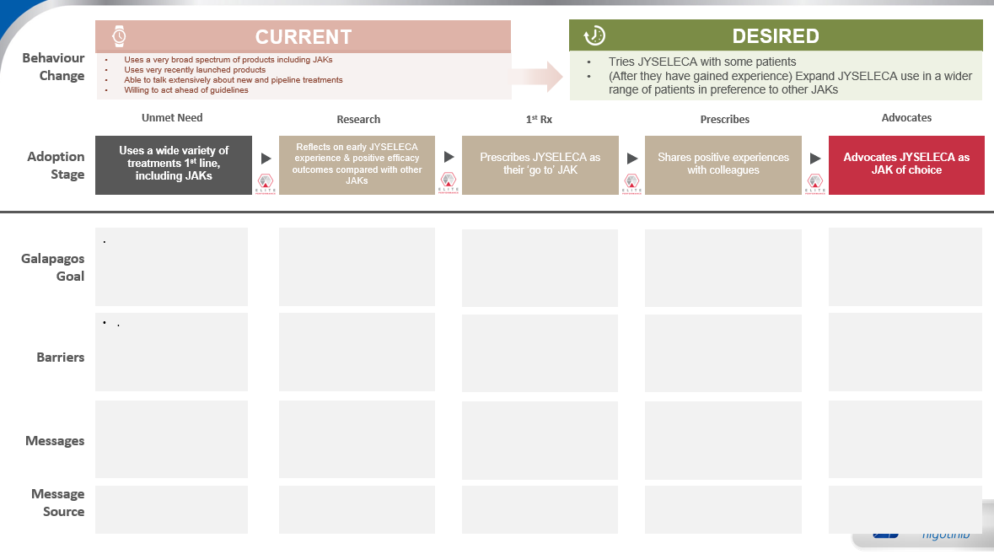

HCP Journey Components
In order to accelerate the creation of the journeys, in our experience it is valuable to first discuss the constituents of the Journeys.
Journey Scenarios
Segmentation
HCP Journeys
Behavioural Research
Key events
Adoption Ladder
Content & Channels
“Moments of Truth”

Slide 14


HCP Journey Scenarios
We can create HCP Journeys based on different categories or Scenarios, for example:
Field-Driven
HCP-Driven
Event-Driven
Rep and Medical journeys will be different, but they will work alongside each other.
(Medical have knowledge ladder)
Rep journeys – adoption ladder focused – route to Rx.
Multiple segmentation dimensions – priority, medical, commercial…
Flexible in how the targets are
Designed for the ‘core’ prescription target audience of Gis

Slide 15

What are we building the journeys for?
Pre Launch Unbranded/Medical (Market Shaping)
Post Launch Branded 1-5
Notes
Market shaping is a key focus
Post launch, +3-6 months to get things moving
Launch -6 → Launch +6
(don’t have an unbranded adoption ladder, making this difficult to measure)
Post-approval/Pre-reimbursement to discuss JAK1 (stage 2)
The Scenarios apply, however different importance… eg event driven is more important during market shaping.

Slide 16
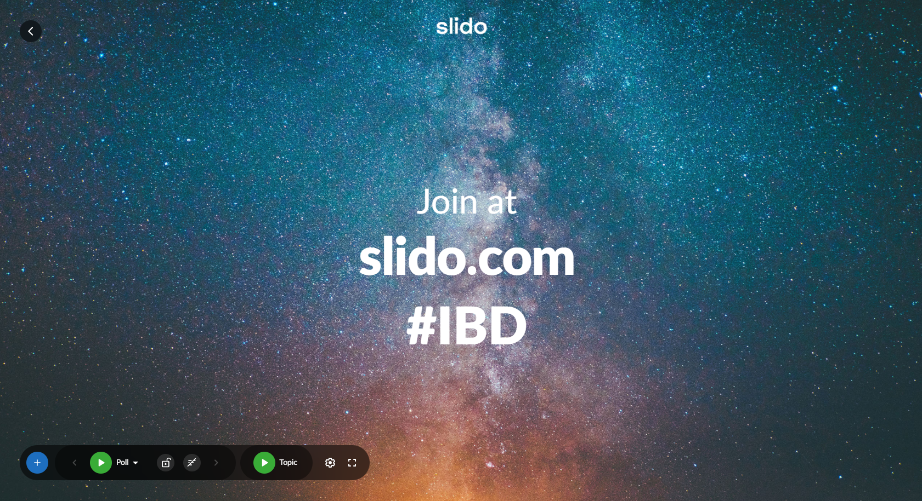
https://app.sli.do/event/c6aiwblm

Slide 17

Decision
Which are the Key Events we want to incorporate ?
National Launch Events
UEGW
ECCO
World IBD Day (May 19)
Lunch & Learns
Local & International Conferences
Masterclass Series
EFPIA Events
Non-owned PR
Key Congresses
Press Releases
National Gastro Society
Publication of selected manuscripts
clinical trial p[ortal
HPC portal
5 mins

Slide 18
Decision
Which are the Milestones we want to consider ?
1st patient identified
1st prescription
First positive experience results
Hospital pharmacies ordering product
5 mins

Slide 19
Decision
Which are the Scenarios or Journey Categories?
Rep-Driven
HCP Driven
Event Driven
5 mins
Agree? Anything other scenarios not included?

Slide 20
Progress Sharing & Tool Demo

Slide 21




SCIENCE FIRST
(1 of 2)
Behaviour Change
CURRENT
Behaviour: Uses JAK inhibitors in 2nd/3rd line in a flexible approach. Persists within the same tx class.
Belief: Flexible approach is optimal. Mucosal healing & long-term remission are key treatment goals.
DESIRED
Behaviour: Uses 1st line in bio-naive. Uses JYSELECA as their advanced treatment of choice.
Belief: JYSELECA’s efficacy, safety and convenience data is comprehensive and differentiating. I will identify candidates to trial first line.
Current
Try JYSELECA
Expand Use
Use 2nd Line
Use 1st line in bio-naive
Adoption Stage
#1
#2
#3
#4
#5
Change behaviour from current 2nd/3rd line JAK inhibitor use to JYSELECA 1st line in bio-naive
Identify & trial JYSELECA in a patient who would benefit from a new mode of action and reassured by the mucosal healing & histologic remission achieved
Identify a wider pool of patients who are not adequately controlled & use JYSELECA to achieve mucosal healing & long-term results
Expand usage of JYSELECA as oral, that does not need steroid and provides the depth of sustained remission that they are looking for
Uses JYSELECA as their advanced treatment of choice
Galapagos Goal
Good options now
New MoAs are no more effective
Convenience is not driving long term remission
Barriers
Detailed in steps 2,3,4
Efficacy Messaging Objective: Focus on sustained remission including mucosal healing and CS-free remission
Detailed Messaging:
JYSELECA was evaluated in bio-naïve & bio-experienced patients with highly active disease
Demonstrated significant clinical and complete histologic remission at week 58
First therapy to meet ≥6-month CS-free clinical remission endpoint in a pivotal study
JYSELECA demonstrated significant mucosal healing at Week 58
JYSELECA is affective as monotherapy
Safety Messaging Objective: Highlight new MOA, demonstrated & consistent safety & tolerability profile
Detailed Messaging:
JYSELECA is a JAK1-preferential inhibitor with >5x potency for JAK1 over other JAK isoforms
Demonstrated safety and tolerability profile in UC studies
Low rates of special interest AEs
Low rates of serious AEs similar to placebo & low discontinuation rates (<5%)
Consistent safety profile across 7 studies in RA patients with over 5400 patient years of clinical exposure
Convenience Messaging Objective: Leverage the simplicity of oral ‘away from hospital’ treatment
Detailed Messaging:
JYSELECA is a simple once-daily 200-mg oral tablet
Same dose for induction and maintenance
Minimal monitoring
No immunogenicity and TDM
No infusions or injections
Limited need for hospital visits
Affirm positive experiences with JYSELECA and support use as advanced treatment of choice.
Identify potential advocates and influencers.
Messages
Message Source
Refer to Message Source Slide
Refer to Message Source Slide
Refer to Message Source Slide

Slide 22
SCIENCE FIRST
(2 of 2)
Behaviour Change
CURRENT
Behaviour: Uses JAK inhibitors in 2nd/3rd line in a flexible approach. Persists within the same tx class.
Belief: Flexible approach is optimal. Mucosal healing & long-term remission are key treatment goals.
DESIRED
Behaviour: Uses 1st line in bio-naive. Uses JYSELECA as their advanced treatment of choice.
Belief: JYSELECA’s efficacy, safety and convenience data is comprehensive and differentiating. I will identify candidates to trial first line.
Current
Try JYSELECA
Expand Use
Use 2nd Line
Use 1st line in bio-naive
Adoption Stage
#1
#2
#3
#4
#5
Messages
Efficacy Messaging Objective: Focus on sustained remission including mucosal healing and CS-free remission
Detailed Messaging:
JYSELECA was evaluated in bio-naïve & bio-experienced patients with highly active disease
Demonstrated significant clinical and complete histologic remission at week 58
First therapy to meet ≥6-month CS-free clinical remission endpoint in a pivotal study
JYSELECA demonstrated significant mucosal healing at Week 58
JYSELECA is affective as monotherapy
Safety Messaging Objective: Highlight new MOA, demonstrated & consistent safety & tolerability profile
Detailed Messaging:
JYSELECA is a JAK1-preferential inhibitor with >5x potency for JAK1 over other JAK isoforms
Demonstrated safety and tolerability profile in UC studies
Low rates of special interest AEs
Low rates of serious AEs similar to placebo & low discontinuation rates (<5%)
Consistent safety profile across 7 studies in RA patients with over 5400 patient years of clinical exposure
Convenience Messaging Objective: Leverage the simplicity of oral ‘away from hospital’ treatment
Detailed Messaging:
JYSELECA is a simple once-daily 200-mg oral tablet
Same dose for induction and maintenance
Minimal monitoring
No immunogenicity and TDM
No infusions or injections
Limited need for hospital visits
Affirm positive experiences with JYSELECA and support use as advanced treatment of choice.
Identify potential advocates and influencers.
Message Source / Channel
TS - eDA efficacy pages & leave behind
Email - SF 1 RTE 1
Media - SF 1 banner ad and email
Media – SF 1 journal ad
Web - JYSELECA HCP Portal
SF self-led DA
KOL SELECTION video
FAQ Podcasts
Conference - Exhibition Booth
Medical affairs activities
TS - eDA - MoA/safety pages & leave behind
Email - SF 2 RTE
Media - SF 2 banner ad and email
Media - SF 2 journal ad
Web - JYSELECA HCP Portal
SGF self-led DA
MoA video
FAQ Podcasts
Conference - Exhibition Booth
Medical affairs activities
TS - eDA - convenience pages & leave behind
TS - Patient brochure
Email - SF 3 RTE
Media - SF 3 banner ad and email
Media - SF 3 journal ad
Web - JYSELECA HCP portal
SF self-led DA
Real life patient cases
Conference – Exhibition Booth
Medical affairs activities

Slide 23
The Tool – Live Demo

Slide 24
Custellence
After comparing a multitude of tools, we believe Custellence has the best balance of features vs simplicity, with simplicity being key.
Custellence is a simple, 1-page journey creation tool, with collaboration functionality.
We are using Custellence solely to help guide the creation of HCP Journeys, not for use in the orchestration or execution of journeys.

Slide 25
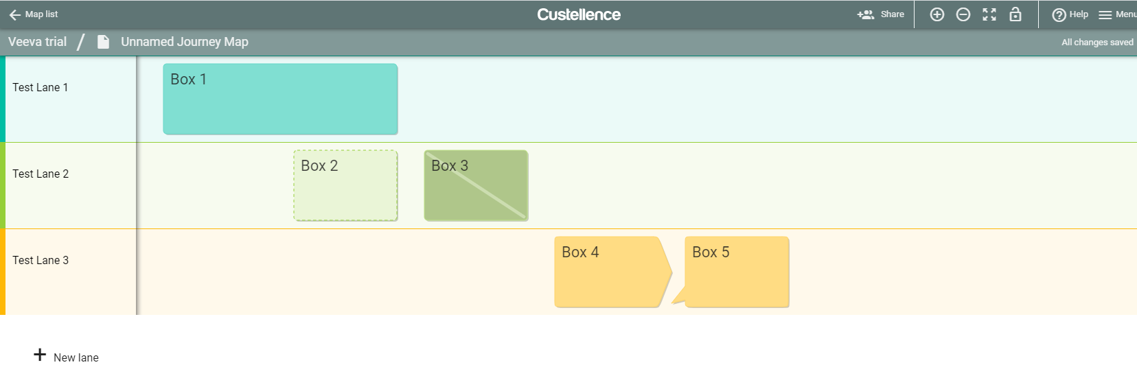
The tool is arranged in ‘lanes’, with boxes
Boxes can be different sizes
Boxes can be assigned different ‘statuses’
Different types of boxes can be added to the lanes

Slide 26
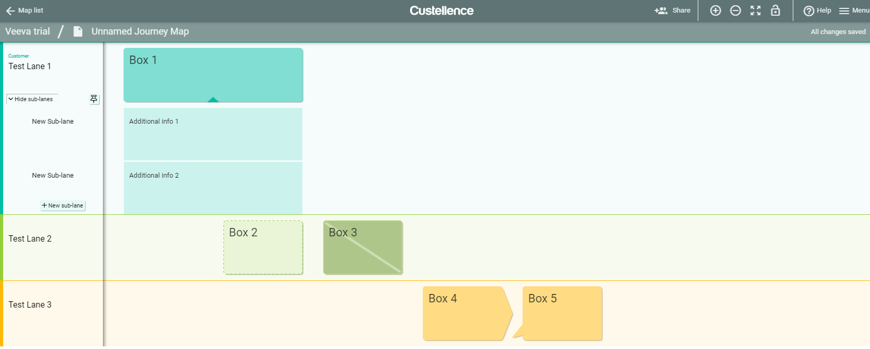
‘Sub-lanes’ can be hidden within a lane
Additional Lanes

Slide 27
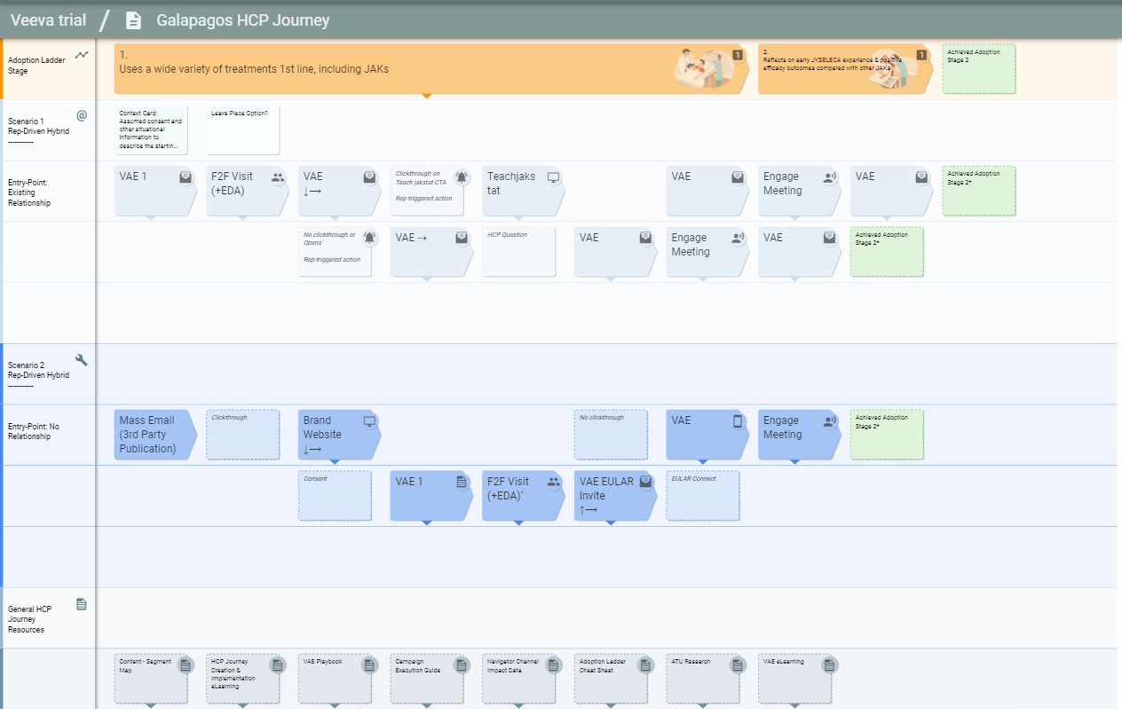
The Journey Map Template
Details

Slide 28
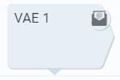
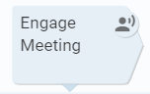
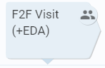
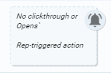
We have defined different box types
Channel boxes are arrow-shaped and the type demonstrated by the box icon/
Other boxes are square and more ‘transparent’, which outlines a connecting action, such as an email click-through or no clickthrough

Slide 29
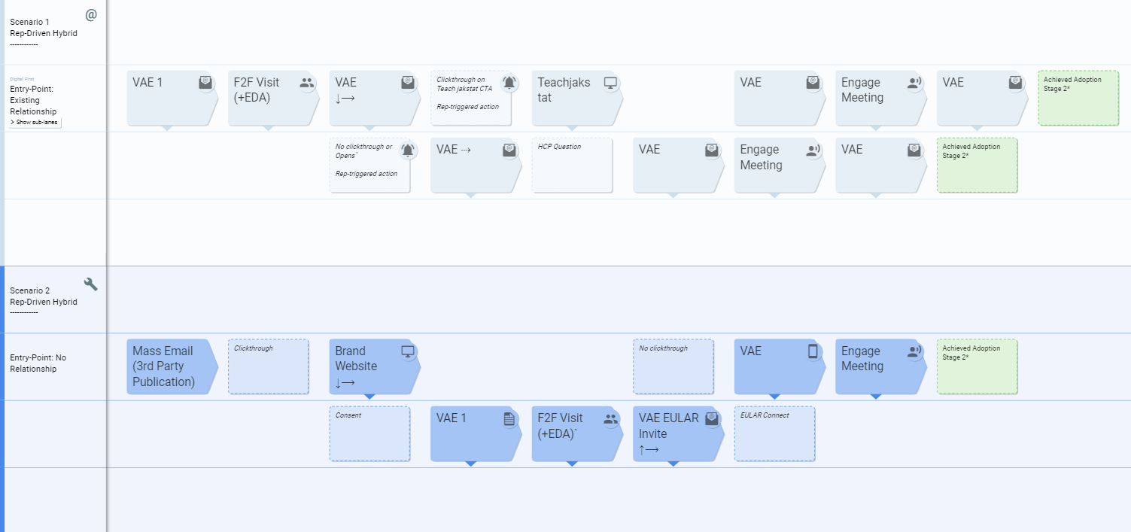
The different scenarios will be colour coded by their lanes

Slide 30
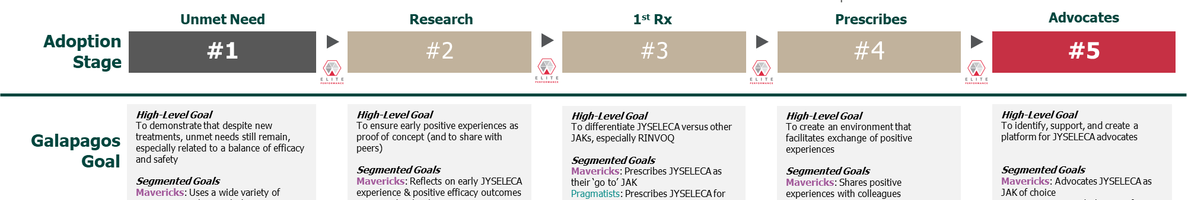
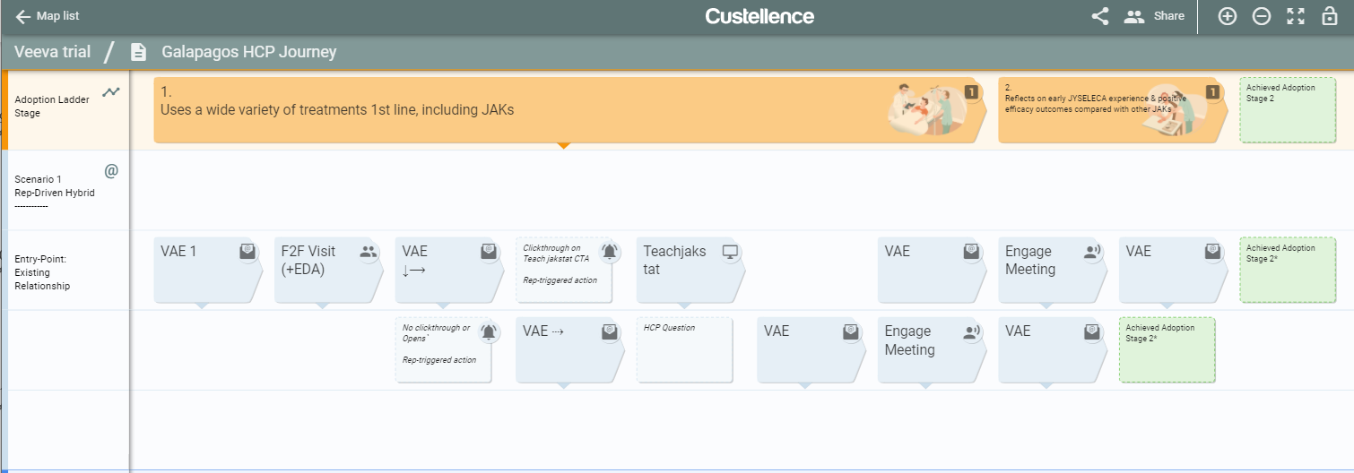
The Adoption stage is highlighted in the top row

Slide 31
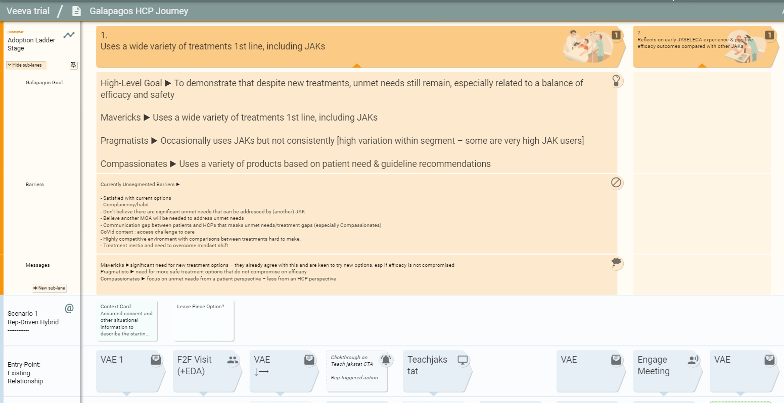
Additional adoption stage detail is hidden in the sub-lanes
Sub-lanes

Slide 32
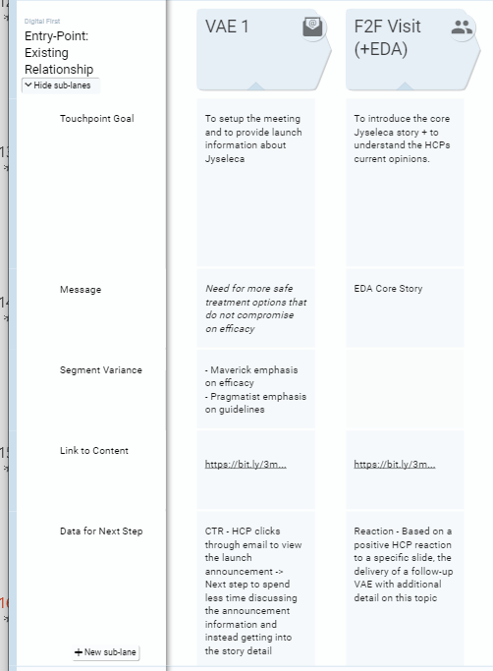
Details about each touchpoint is also hidden in sub-lanes

Slide 33
Working Session - Custellence®

Slide 34
Customer Journey Using Custellence®
How can we refine and complete the customer journeys?

Slide 35
In two groups, we will pursue the work on the current Customer Journeys using Custellence®
Group 1
Patrick
Geert
Clare
Johan
Arsida
Veronica
Natalya
Abi
Group 2
Elisa
Deborah
Secil
Camille
Neil
Anjela
Alice
Nancy
Veeva
Leads
Gareth
The Alexes
Notes:
Patrick, Elisa, Deborah, Geert, Alessandra, Secil, Camille, Clare, Johan
Alexandre/Gareth/Alex (Veeva) Arsida/Anjela/Neil/Veronica (DDB) Alice (OpenHealth)

Slide 36
Debrief

Slide 37
Next Steps

Slide 38
Following Today’s Session
Action | Who | When
Continue build of HCP Journeys following lessons learned & outcomes of today’s session | Veeva
Review Draft HCP Journeys (combination of virtual meetings & offline review) | Core Team
Provide UC team access to Custellence | Veeva

Slide 39
Appendix

Slide 40
PATIENT FIRST
(1 of 2)
Behaviour Change
CURRENT
Behaviour: Use JAKs for a limited number of patients and use steroids for quick symptom relief & QoL.
Belief: Top-down approach is optimal. Patient preference is important. Excited about the JAK-STAT pathway.
DESIRED
Behaviour: Use 1st line in bio-naïve. Uses JYSELECA as their advanced treatment of choice.
Belief: I am confident that JYSELECA is the right solution b/c of efficacy/safety and convenience. I have candidates to trial JYSELECA first-line.
Current
Try JYSELECA
Ask all Patients
Use 2nd Line
Use 1st line in bio-naive
Adoption Stage
#1
#2
#3
#4
#5
Change behaviour from current limited 1st line JAK inhibitor use to JYSELECA as their advanced treatment of choice
Identify & trial JYSELECA to achieve rapid control & symptom relief for a patient who is struggling with their symptoms & burden of treatment
Ask all patients (naïve/ exp) whether they would prefer an oral treatment providing rapid efficacy & the safety profile that the patient needs
Choose JYSELECA as standard of care oral after first biologic failure as the most simple & convenient solution for their patient
Uses JYSELECA as their advanced treatment of choice
Galapagos Goal
Use of steroids
Convenience as one driver for treatment choice
Safety concerns with some therapies
Barriers
Detailed in steps 2,3,4
Efficacy Messaging Objective: Focus on rapid symptom relief, sustained efficacy and QoL improvements
Detailed Messaging:
It’s time for JYSELECA, a 2nd generation, once-daily, oral JAK inhibitor
Rapid reduction in the frequency of bloody diarrhea as early as week 2
Mucosal healing with a significant reduction in rectal bleeding and stool frequency at week 10
JYSELECA could help patients return to their normal lives
Convenience Messaging Objective: Highlight simplicity for the patient that is above and beyond once-daily oral
Detailed Messaging:
Side effects/therapeutic drug monitoring & parenteral/sub-cutaneous administration are factors contributing to the burden of UC treatment for some patients
JYSELECA is a simple once-daily 200-mg oral tablet
Same dose for induction and maintenance
Minimal monitoring
No immunogenicity and TDM
Safety Messaging Objective: Address any potential safety concerns and be reassured of the simple choice
Detailed Messaging
JYSELECA is a JAK1-preferential inhibitor with >5x potency for JAK1 over other JAK isoforms
Demonstrated safety and tolerability profile in UC studies
Low rates of special interest Aes
Low rates of serious AEs similar to placebo & low discontinuation rates (<5%)
Jyseleca is the simple solution for you and your patients
Affirm positive experiences with JYSELECA and support use as advanced treatment of choice.
Identify potential advocates and influencers.
Messages
Message Source
Refer to Asset Overview Slide
Refer to Asset Overview Slide
Refer to Asset Overview Slide
Refer to Asset Overview Slide
Refer to Asset Overview Slide

Slide 41
PATIENT FIRST
(2 of 2)
Behaviour Change
CURRENT
Behaviour: Use JAKs for a limited number of patients and use steroids for quick symptom relief & QoL.
Belief: Top-down approach is optimal. Patient preference is important. Excited about the JAK-STAT pathway.
DESIRED
Behaviour: Use 1st line in bio-naïve. Uses JYSELECA as their advanced treatment of choice.
Belief: I am confident that JYSELECA is the right solution b/c of efficacy/safety and convenience. I have candidates to trial JYSELECA first-line.
Current
Try JYSELECA
Ask all Patients
Use 2nd Line
Use 1st line in bio-naive
Adoption Stage
#1
#2
#3
#4
#5
Messages
Efficacy Messaging Objective: Focus on rapid symptom relief, sustained efficacy and QoL improvements
Detailed Messaging:
It’s time for JYSELECA, a 2nd generation, once-daily, oral JAK inhibitor
Rapid reduction in the frequency of bloody diarrhea as early as week 2
Mucosal healing with a significant reduction in rectal bleeding and stool frequency at week 10
JYSELECA could help patients return to their normal lives
Convenience Messaging Objective: Highlight simplicity for the patient that is above and beyond once-daily oral
Detailed Messaging:
Side effects/therapeutic drug monitoring & parenteral/sub-cutaneous administration are factors contributing to the burden of UC treatment for some patients
JYSELECA is a simple once-daily 200-mg oral tablet
Same dose for induction and maintenance
Minimal monitoring
No immunogenicity and TDM
Safety Messaging Objective: Address any potential safety concerns and be reassured of the simple choice
Detailed Messaging
JYSELECA is a JAK1-preferential inhibitor with >5x potency for JAK1 over other JAK isoforms
Demonstrated safety and tolerability profile in UC studies
Low rates of special interest Aes
Low rates of serious AEs similar to placebo & low discontinuation rates (<5%)
Jyseleca is the simple solution for you and your patients
Affirm positive experiences with JYSELECA and support use as advanced treatment of choice.
Identify potential advocates and influencers.
Message Source / Channel
TS - eDA efficacy pages & leave behind
Email - PF 1 RTE
Media - PF 1 banner ad and email
Media - PF 1 journal ad
Web - JYSELECA HCP Portal
PF self-led DA
FAQ Podcasts
Real life patient cases (bio-naïve)
Conference - Exhibition Booth
Medical affairs activities
TS - eDA convenience pages & leave behind
Email - PF 2 RTE
Media - PF 2 banner ad and email
Media - PF 2 journal ad
Web - JYSELECA HCP Portal
PF self-led DA
Patient brochure
Real life patient cases (bio-naïve)
Conference - Exhibition Booth
Medical affairs activities
TS – eDA safety pages & leave behind
Email – PF 3 RTE
Media – PF 3 banner ad and email
Media – PF 3 journal ad
Web – JYSELECA HCP Portal
PF self-led DA
MOA video
RMM
FAQ Podcasts
Real life patient cases
Conference - Exhibition Booth
Medical affairs activities

Slide 42
FAMILIARITY FIRST
(1 of 2)
Behaviour Change
CURRENT
Behaviour: Use a cautious step-up approach & very rare use of JAKs.
Belief: Cautious step-up approach gives confidence. Current therapies work for most patients. New MoAs are worth considering.
DESIRED
Behaviour: Use 2nd Line - start to use JYSELECA as first option after 1st biologic failure based on the positive feedback they have received from patients.
Belief: Experts are recommending new MoAs. JYSELECA is a simple & safe new option. Considering after 1st biologic failure.
Current
Discuss JYSELECA
Trial JYSELECA in 3rd Line
Expand Use
Use 2nd Line
Adoption Stage
#1
#2
#3
#4
#5
Use a cautious step-up
approach & very rare use of JAKs
Open to discuss JYSELECA as a safe & simple option in their treatment paradigm
Trial JYSELECA in a 3rd line treatment based on peer-feedback reassuring on the safety profile – develop a case study on this patient
Expand use of JYSELECA in 3rd line – tried and tested based on their own experience
Start to use JYSELECA as the first option after 1st biologic failure based on the positive feedback they have received from their patients
Galapagos Goal
Satisfied with current therapies
Anti-TNFs effective & safe
Safety concern about Jak Class
Barriers
Detailed in 2,3,4
Benefits Messaging Objective: Focus on sustained remission and safety in bio-experienced
Detailed Messaging:
Experts are recommending rapid introduction of advanced therapies to improve patient outcomes in moderate-to-severe UC
Demonstrated significant clinical remission at week 58
First therapy to meet ≥6-month CS-free clinical remission endpoint in a pivotal study
Favourable safety and tolerability profile in UC studies
Consistent safety profile across 7 studies in RA patients with over 5400 patient years of clinical exposure
Safety Messaging Objective: Address potential safety concerns by leveraging preferential MOA
Detailed Messaging:
It’s time to consider JYSELECA, a 2nd generation, once-daily, oral JAK inhibitor
Demonstrated safety and tolerability profile in UC studies
Low rates of special interest AEs
Low rates of serious AEs similar to placebo & llow discontinuation rates (<5%)
JYSELECA demonstrated significant mucosal healing at week 58
Convenience Messaging Objective: Highlight simplicity for the patient and no immunogenicity
Detailed Messaging
JYSELECA is a simple once-daily 200-mg oral tablet
No immunogenicity and TDM
Same dose for induction and maintenance
Minimal monitoring
JYSELECA could help patients return to their normal lives
Affirm positive experiences with JYSELECA and support use as 2L advanced treatment of choice.
Messages
Message Source
Refer to Asset Overview Slide
Refer to Asset Overview Slide
Refer to Asset Overview Slide
Refer to Asset Overview Slide
Refer to Asset Overview Slide

Slide 43
FAMILIARITY FIRST
(2 of 2)
Behaviour Change
CURRENT
Behaviour: Use a cautious step-up approach & very rare use of JAKs.
Belief: Cautious step-up approach gives confidence. Current therapies work for most patients. New MoAs are worth considering.
DESIRED
Behaviour: Use 2nd Line - start to use JYSELECA as first option after 1st biologic failure based on the positive feedback they have received from patients
Belief: Experts are recommending new MoAs. JYSELECA is a simple & safe new option. Considering after 1st biologic failure.
Current
Discuss JYSELECA
Trial JYSELECA in 3rd Line
Expand Use
Use 2nd Line
Adoption Stage
#1
#2
#3
#4
#5
Messages
Benefits Messaging Objective: Focus on sustained remission and safety in bio-experienced
Detailed Messaging:
Experts are recommending rapid introduction of advanced therapies to improve patient outcomes in moderate-to-severe UC
Demonstrated significant clinical remission at week 58
First therapy to meet ≥6-month CS-free clinical remission endpoint in a pivotal study
Favourable safety and tolerability profile in UC studies
Consistent safety profile across 7 studies in RA patients with over 5400 patient years of clinical exposure
Safety Messaging Objective: Address potential safety concerns by leveraging preferential MOA
Detailed Messaging:
It’s time to consider JYSELECA, a 2nd generation, once-daily, oral JAK inhibitor
Demonstrated safety and tolerability profile in UC studies
Low rates of special interest AEs
Low rates of serious AEs similar to placebo & llow discontinuation rates (<5%)
JYSELECA demonstrated significant mucosal healing at week 58
Convenience Messaging Objective: Highlight simplicity for the patient and no immunogenicity
Detailed Messaging
JYSELECA is a simple once-daily 200-mg oral tablet
No immunogenicity and TDM
Same dose for induction and maintenance
Minimal monitoring
JYSELECA could help patients return to their normal lives
Affirm positive experiences with JYSELECA and support use as 2L advanced treatment of choice.
Message Source / Channel
TS - eDA - unmet needs and efficacy/safety benefit pages & leave behind
Email - FF 1 RTE
Media - FF 1 email and banner ad
Media - FF 1 journal ad
Web - JYSELECA HCP Portal
FF self-led DA
FAQ Podcasts
Conference - Exhibition Booth
Medical affairs activities
TS - eDA - safety benefits pages & leave behind
Email - FF 2 RTE
Media - FF 2 email and banner ad
Media - FF 2 journal ad
Web - JYSELECA HCP Portal
FF self-led DA
FAQ Podcasts
Real life patient cases (bio-experienced)
Conference - Exhibition Booth
Medical affairs activities
TS - eDA - convenience and safety pages & leave behind
TS - patient brochure
Email - FF 3 RTE
Media - FF 3 email and banner ad
Media - FF 3 journal ad
Web - JYSELECA HCP Portal
FF self-led DA
FAQ Podcasts
Real life patient cases (bio-experienced)
Conference – Exhibition Booth
Medical affairs activities

Slide 44

This work would normally require 3 weeks, we offer to streamline to 3 workshops across 2 months
The engagements are spread over 3-4 weeks, and respect local agendas
Suggest to remove – this repeats information from the previous slide
GA: I guess it gives a more detailed view of what the market engagement looks like? We could just cover this within s11 though tbf
First Engagement
during MOC meeting (1hr)
Gather market buy-in for project and define joint objectives
Workshop 1 (2hr)
Local adoption ladder finalisation,
Local HCP journeys initiation using International journeys
Workshop 3 (2hr)
HCP journey finalisation.
Local Signoff
International support
International support
International support
International support
Offline Pre-Work (1-3 weeks)
Gathering of local research, segmentation, strategy, context, content and channel preferences.
Workshop 2 (2hr)
Local HCP Journey iteration

